Slide 1
Fast Food Analysis
Diagnostic Report & Dashboard Insights

Slide 2
Project Roadmap
Phase 1: Data Collection (SQL)
Phase 2: Data Preprocessing (Excel/Power Bi)
Phase 3: Exploratory Data Analysis (Excel).
Phase 4: Dashboard Creation/Visualizations (Power BI).
Phase 5: Dashboard Insights & Presentation.

Slide 3
Project Objective
The objective of the Fast Food Analysis project is to diagnose and evaluate the nutritional quality of fast food items using Power BI dashboards and a sample dataset.
Key goals :
- Analyze nutritional data (calories, fat, sodium, etc.) across restaurants
- Introduce a Health Score to assess food quality
Compare restaurants based on nutritional value
- Visualize insights through interactive Power BI dashboards
Recommend actions for healthier menu planning

Slide 4
Dataset Overview
The dataset includes nutritional attributes of food items across restaurants.
Key columns:
- Restaurant, Item, Calories, Fat, Cholesterol, Sodium, Carbohydrates, Protein
- Vitamins (A, C), Calcium, Sugar, Fiber
- Calculated attributes: Health Score

Slide 5
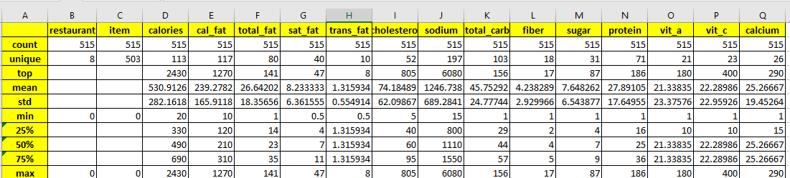
Excel Data Analysis
- Conducted statistical summary on food dataset:
- Count
- Unique values
- Top frequency item
- Mean
- Standard deviation
- Minimum, 25%, 50%, 75%, Maximum values
- Performed correlation analysis.
- Created Pivot Table to aggregate and understand trends.

Slide 6
Analytical Approach
- Data preprocessing and enrichment
- Health score modeling based on nutrients
- Power BI dashboard development:
- Item-level and restaurant-level analysis
- Visual KPIs for calories, fat, sodium
- Insights and recommendations

Slide 7
Dashboard Overview
- Included metrics: Calories, Protein, Total Carbs, Cholesterol, Fat, Calcium.
- Multiple charts and slicers:
- Bar charts for calories and health scores
- Donut charts for nutrient breakdown
- Line graph for average nutrients
- Gauge chart for high-protein items
- Interactive filtering using slicers (restaurant, item).

Slide 8
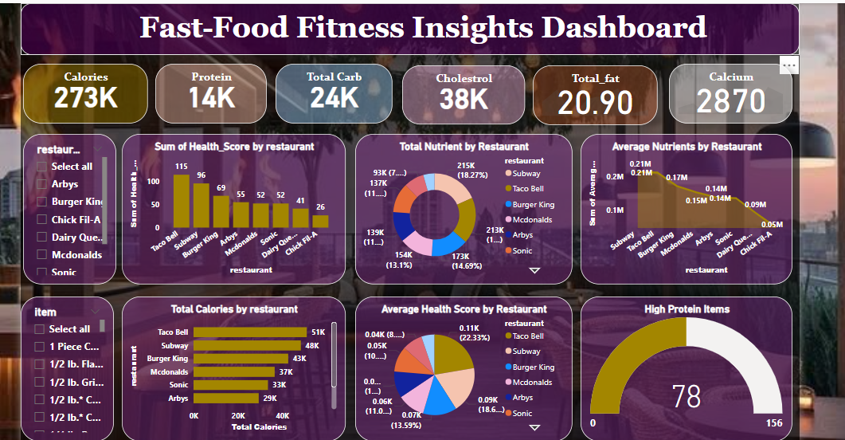
Power BI Dashboards

Slide 9
Data Classification
Classified food items based on healthiness
- Items are labeled with a Health Score (1 = High Healthy, 0 = Low Healthy)
- Healthier items tend to be grilled rather than fried
- Lower calorie and sodium items more likely to be labeled as healthy
- Helped in filtering and scoring items meaningfully in Power BI.

Slide 10
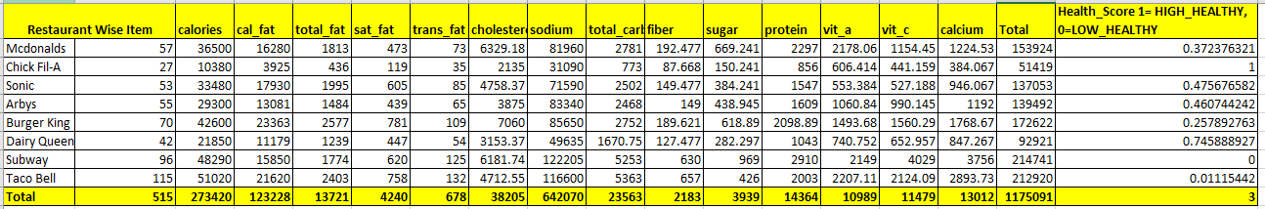
Health Score by Restaurant
Data includes 515 food items across 8 major fast-food chains.
- Metrics: Calories, fats, cholesterol, sodium, carbs, vitamins, etc.
- Health Score: Ranges from 0 (least healthy) to 1 (most healthy).
- Total calories: 273,420 | Total fat: 123,228 | Health Score Sum: 3

Slide 11
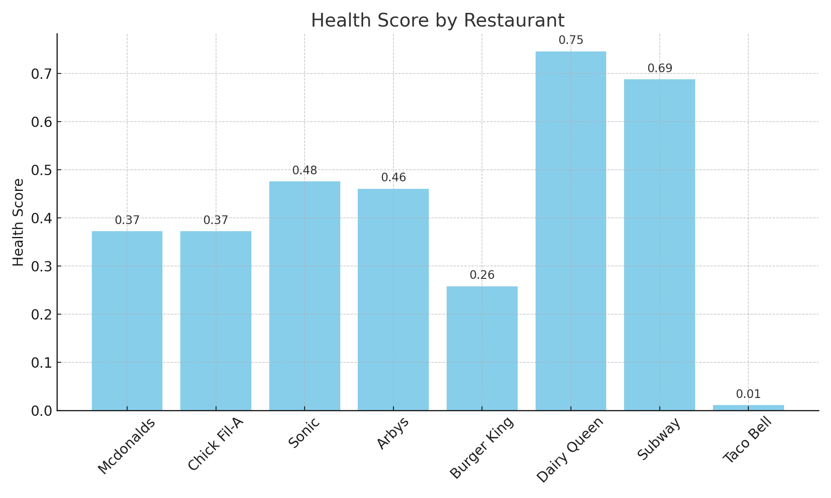
Restaurant Health Score Summary
Dairy Queen (0.7459) - Highest health score.
Subway (0.6877) - High in fiber, protein, vitamins.
Sonic & Arby's - Average health scores.
Chick Fil-A & McDonald's - Lower scores, high sodium.
Burger King - High fat/sodium, low score.
Taco Bell (0.0111) - Lowest score, high calories/sodium.

Slide 12
Key Findings
- Grilled items are healthier than fried alternatives
- Sodium levels are critically high in many products
- Restaurants differ significantly in average nutrition
- Sugar and fat drive low health scores

Slide 13
Recommendations
- Promote low-calorie, grilled, and high-fiber items
- Introduce sodium limits on menu items
- Encourage balanced meals with vegetables and fiber
- Provide real-time nutrition info to customers
Provide insights that can help:
Customers make healthier food choices
Restaurants optimize their menu offerings

Slide 14
Conclusion
- This project successfully delivered a comprehensive diagnostic analysis of fast food nutritional data.
- Successfully built a complete nutritional analysis system.
- Excel supported data understanding and cleaning.
- Power BI delivered interactive visual storytelling.
- Valuable insights gained into fast-food health factors.
• The Health Score model provided a clear framework to distinguish healthy vs. unhealthy items.

Slide 15
Thank You

